Slide 1
Capstone Project
Manhattan venue clustering analysis

Slide 2
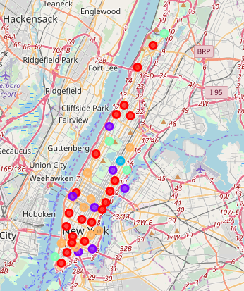
Manhattan venue clusters

Slide 3
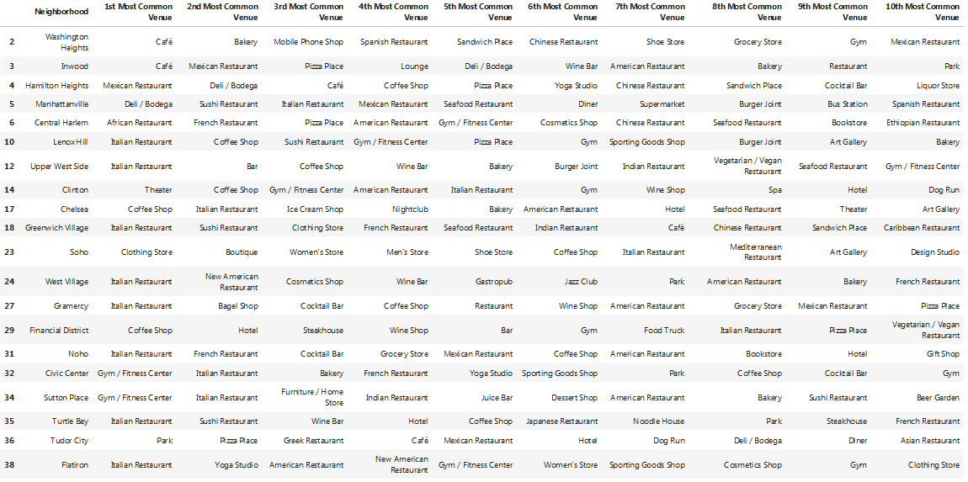
Cluster 1 (red color dots on map) 20 neighborhoods

Slide 4
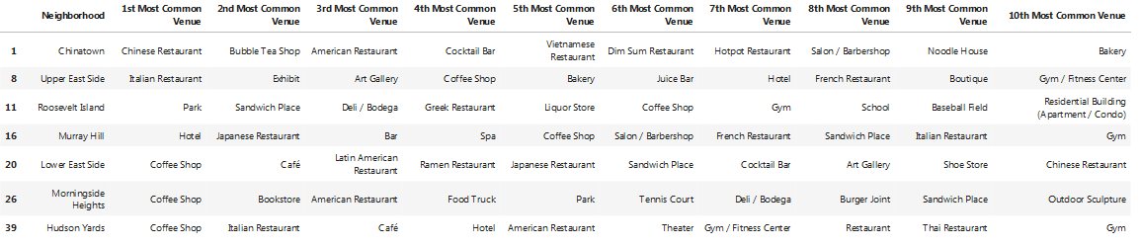
Cluster 2 (purple color dots on map) 7 neighborhoods

Slide 5
Cluster 3 (blue color dots on map) 1 neighborhood

Slide 6
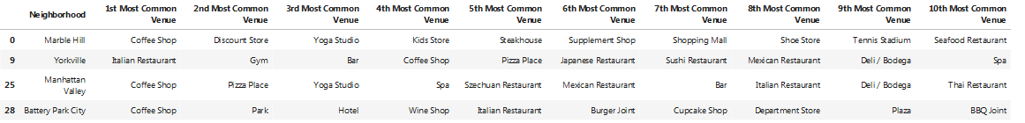
Cluster 4 (key lime color dots on map) 4 neighborhoods

Slide 7
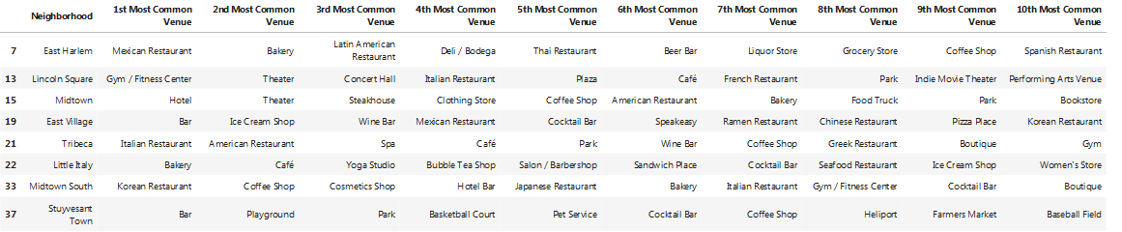
Cluster 5 (peach color dots on map) 8 neighborhoods

